Slide 1
Cloud and Serverless Computing
Build a Video Streaming Service using AWS S3, CloudFront and React
Name - SHASHANK KUMAR
Id - 2100032506
Section - 31

Slide 2
Overview
Create an Amazon S3 Bucket
Upload the pre-recorded video to Amazon S3 Bucket
Create a CloudFront distribution
Create a Basic React App
Deploy the video on the React App
Pre-requisite
an AWS account

Slide 3
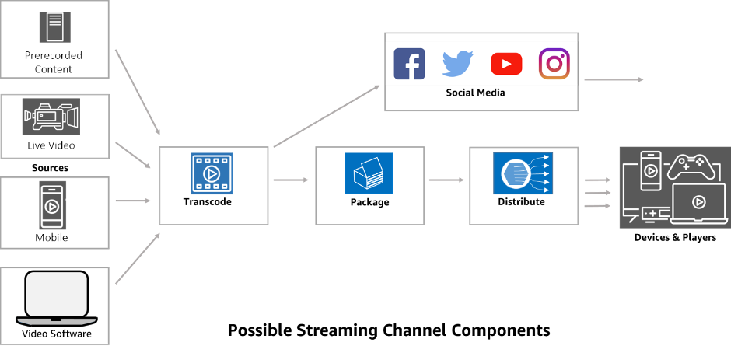
Architecture

Slide 4
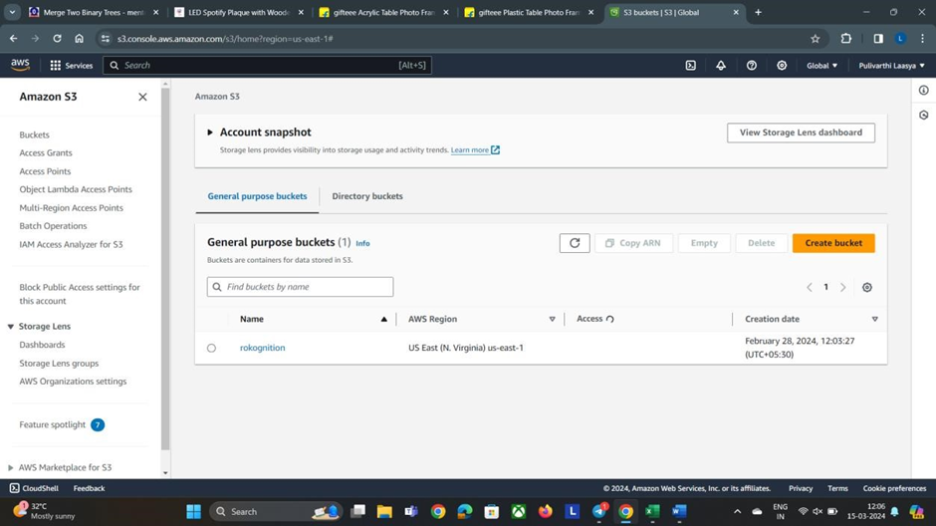
Procedure:
Step 1:Sign in to Amazon console
Step 2: Go to services and search for s3 bucket, and create a bucket

Slide 5
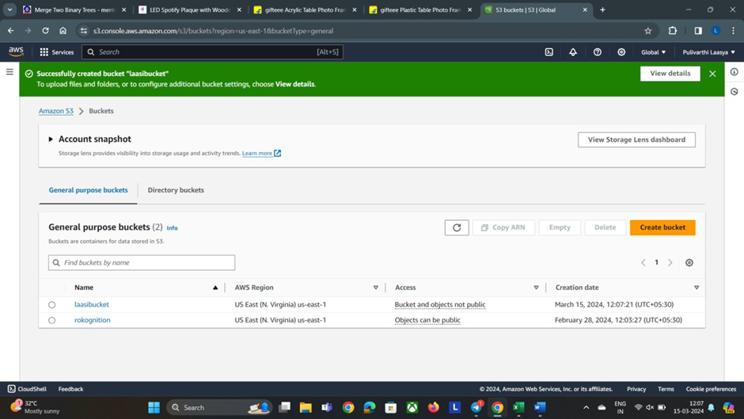
Step 3: After that go to cloud front service in that go to origin access and create a control setting

Slide 6
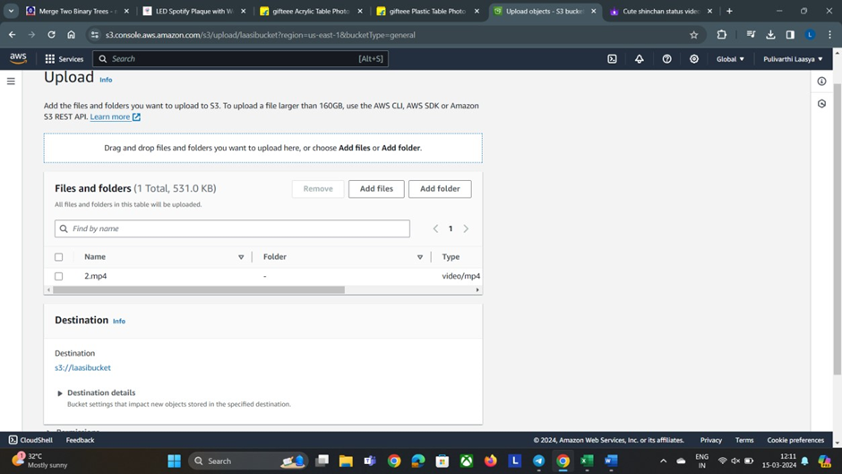
Step 4: Upload Video to S3 Bucket

Slide 7
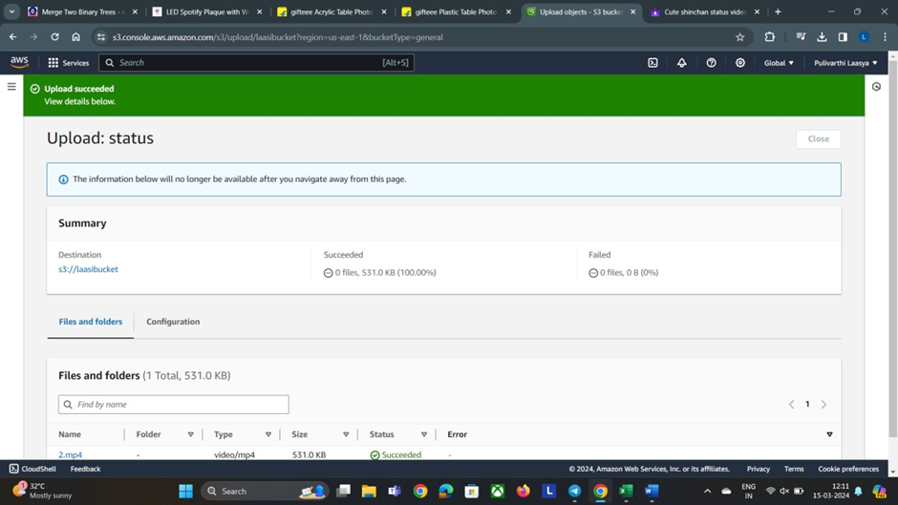
Wait until the status will show succeeded

Slide 8
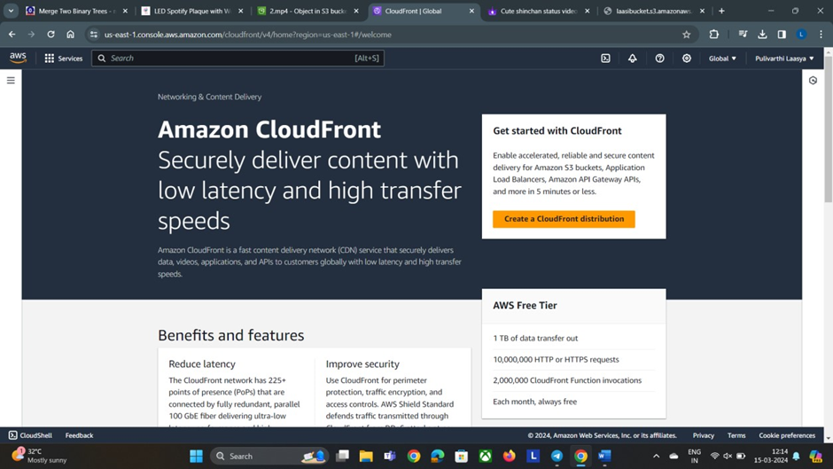
Step 5: After creating control setting, we have to create a distribution in CloudFront

Slide 9
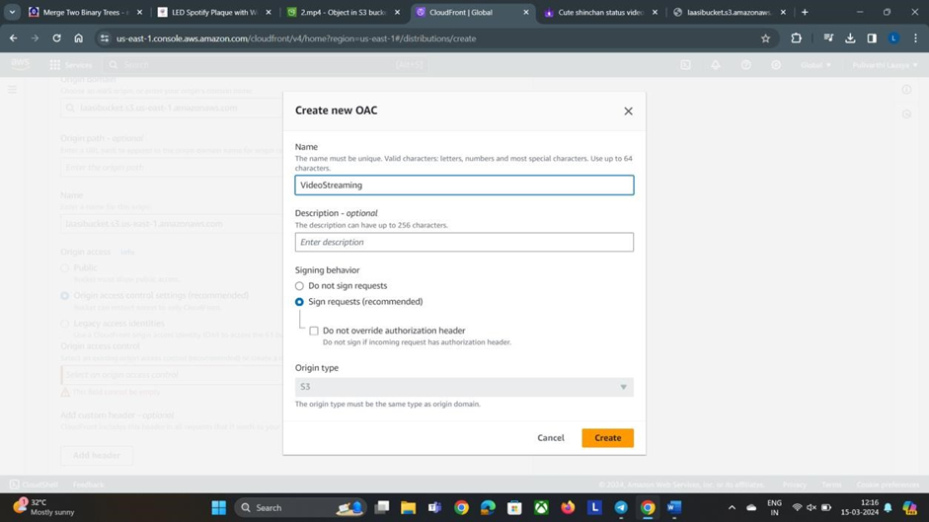

Slide 10
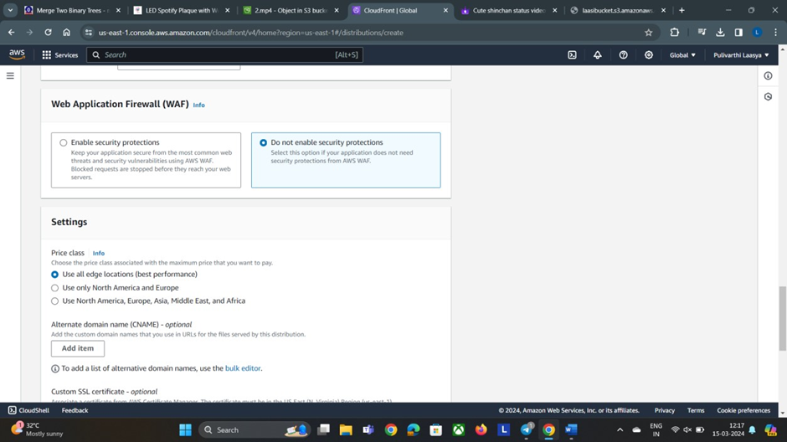

Slide 11
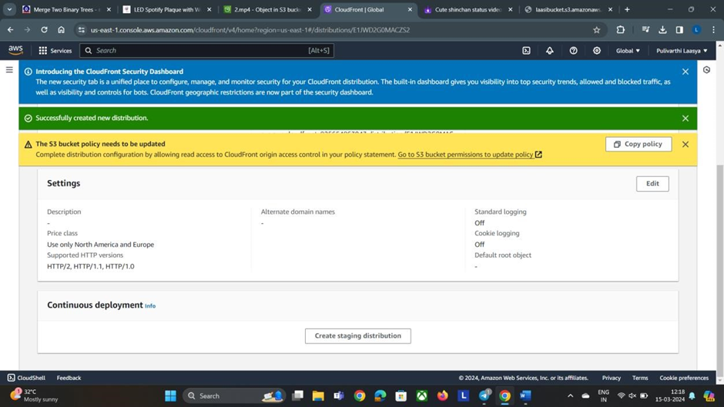

Slide 12
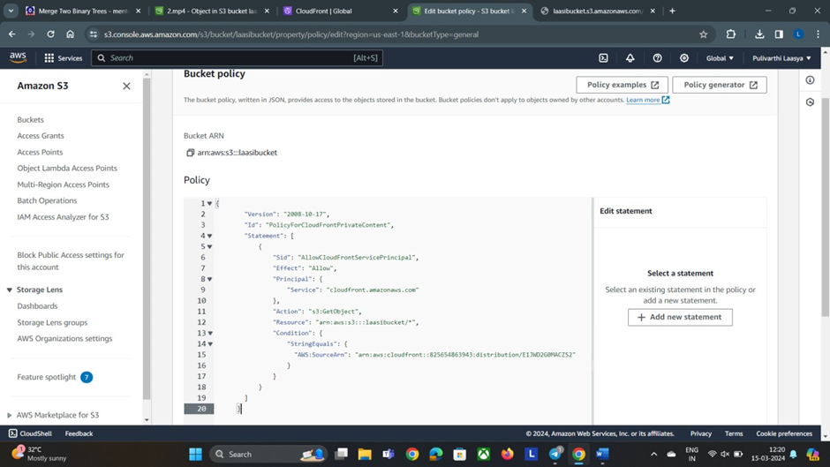
Step 6: Following the creation of the distribution, it is necessary to update the S3 bucket policy accordingly. Copy the provided policy and paste it into the S3 bucket policy editor.

Slide 13
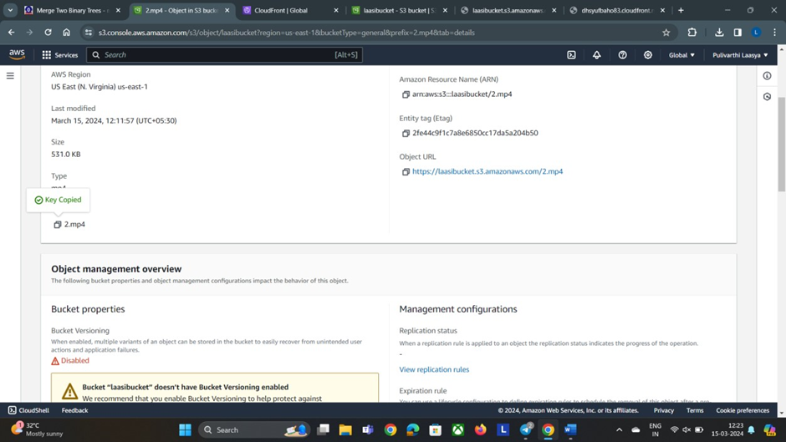

Slide 14
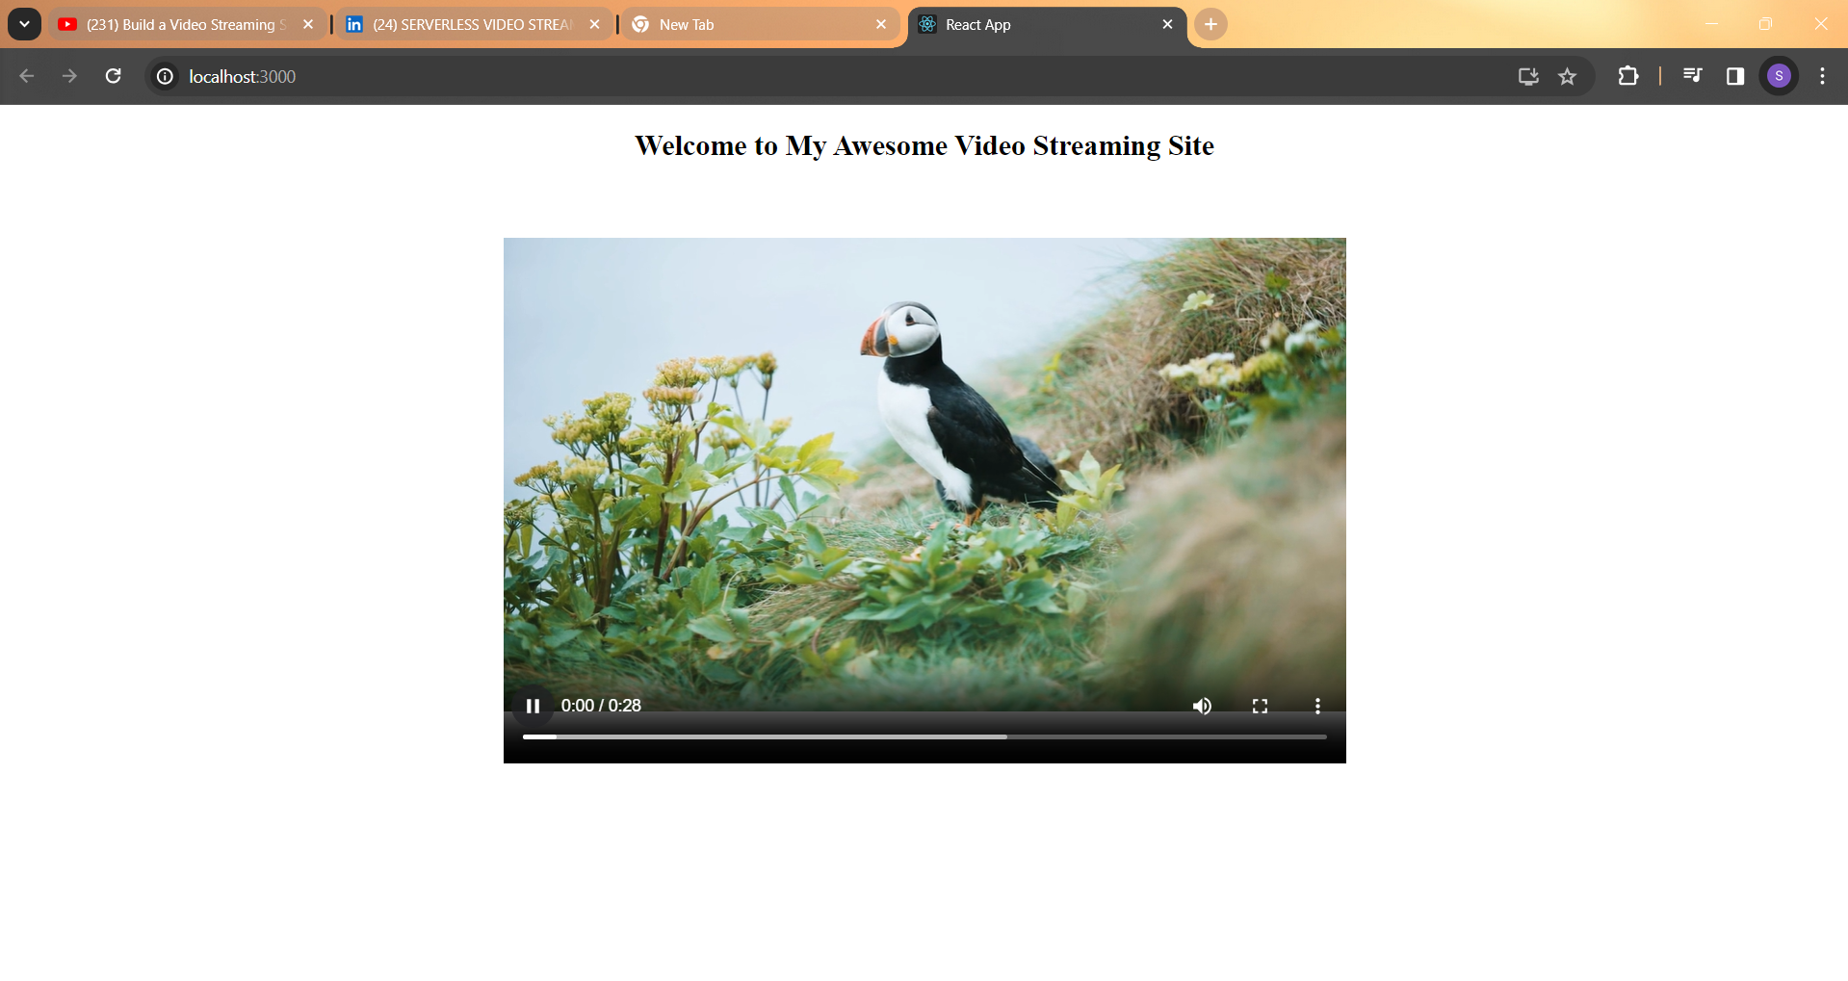
Step 7: Navigate to the Distribution panel, copy the domain name, and paste it into the address bar of a web browser. Then, copy the key name and insert it into the appropriate field in the web browser. Upon completion, the expected outcome should resemble the following:

Slide 15
Conclusion
We've revolutionized video streaming by leveraging Amazon Web Services (AWS), delivering unparalleled scalability, efficiency, and cost-effectiveness. Utilizing AWS tools like S3 and CloudFront, we've simplified operations and reduced complexities. Our serverless architecture ensures seamless streaming tailored to modern digital needs. With AWS, we focus on content excellence, unburdened by traditional server setups.

